Slide 1
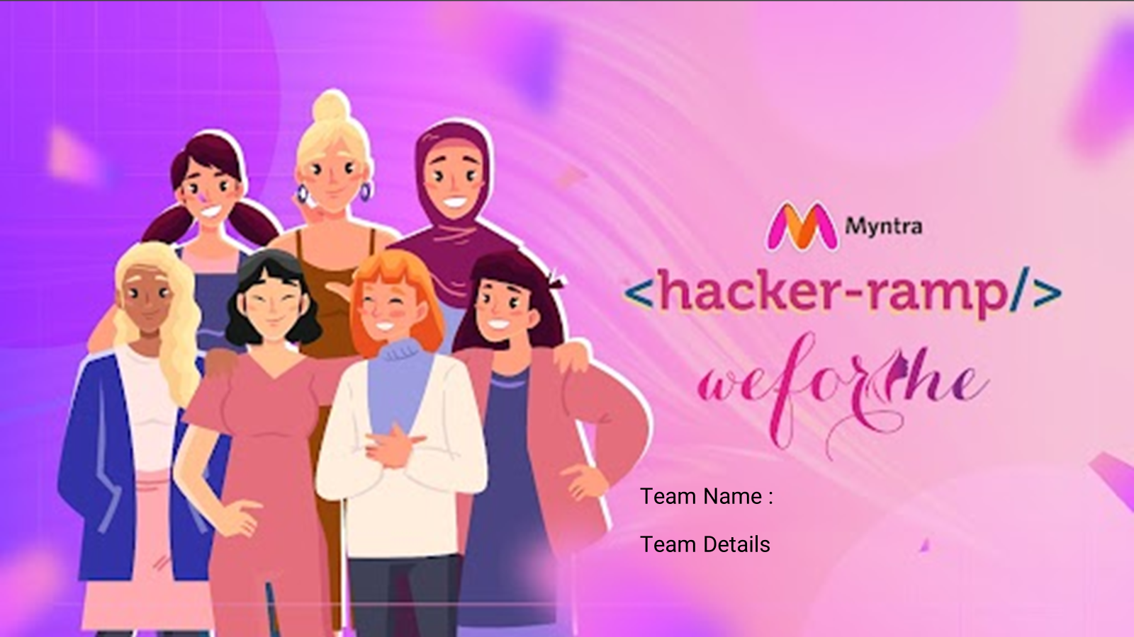
MynChamps
Ananya Bansal (Team Leader)
Saneha Garg (Team Member 1)
Mannat Pruthi (Team Member 2)

Slide 2
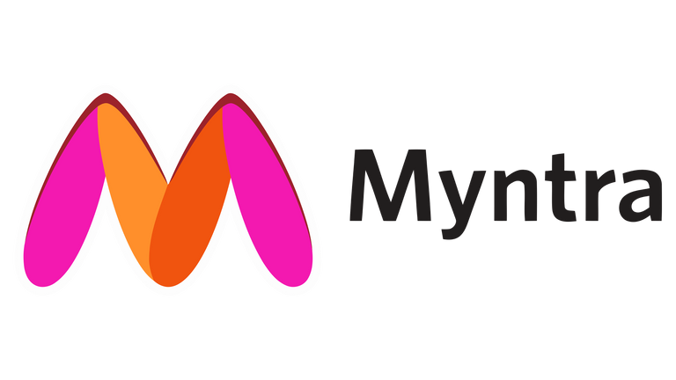
Problem Statement
GlowUp!
#GOAT
TREND-IDENTIFICATION & TREND-CENTRIC RECOMMENDATIONS:
Utilize data analytics and market research to identify emerging fashion trends. Employ AI-driven recommendation systems that analyze current fashion trends, customer preferences, and purchase history to deliver tailored product suggestions, enhancing customer engagement and conversion rates in the fast fashion segment.
SOCIAL SHOPPING INTEGRATION:
Integrate social media functionalities and user-generated content, such as influencer collaborations, customer reviews, and shoppable posts, to create an interactive and immersive shopping experience that resonates with fast fashion enthusiasts, positioning Myntra as the go-to destination, driving customer growth and conversion.

Slide 3
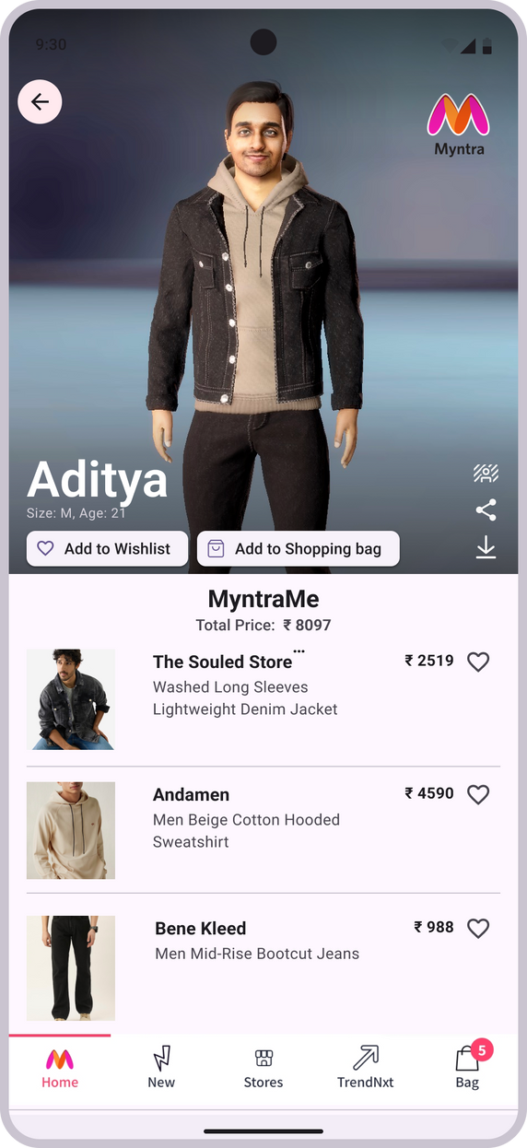



Solution 1
Create your very own MyntraMe!
Idea:
#Slay
MYNTRA'S VIRTUAL FASHION AVATAR FEATURE: MYNTRAME
Step into the future of fashion with Myntra's Virtual Fashion Avatar. Craft your virtual twin and explore a vast selection of clothes, accessories, and shoes in stunning detail. Powered by AI and AR, this feature delivers life-like simulations of fit and style, revolutionising how you shop online. Say goodbye to guesswork, embrace personalised perfection, and elevate your shopping experience.
Select your Details.
Change your background: Bougee, Basic or Lit, as you like!
Share your fit check with your FAM!
Focus:
Download your DRIP
BOOST ENGAGEMENT WITH MYNTRA'S VIRTUAL FASHION AVATAR, CONNECTING AND CAPTIVATING YOUNGER AUDIENCES WITH PERSONALIZED, AI-POWERED FASHION EXPERIENCES.
Get this whole look A$AP!
Platform:
Tech-Stack:
MYNTRA'S MOBILE APPLICATION
Frontend: React Native, Three.js, React Navigation, Redux, Avaturn SDK
Backend: Node.js with Express, MongoDB, AWS Lambda, Firebase, GraphQL
Middle Layer: Redux Thunk, Axios, React Query
API: Avaturn API, Myntra Product API
3D Rendering and Visualisation: Three.js, WebGL
Deployment: CI/CD Tools, Vercel, AWS, Google Play Console, App Store Console
Send
FITCHECK!

Slide 4
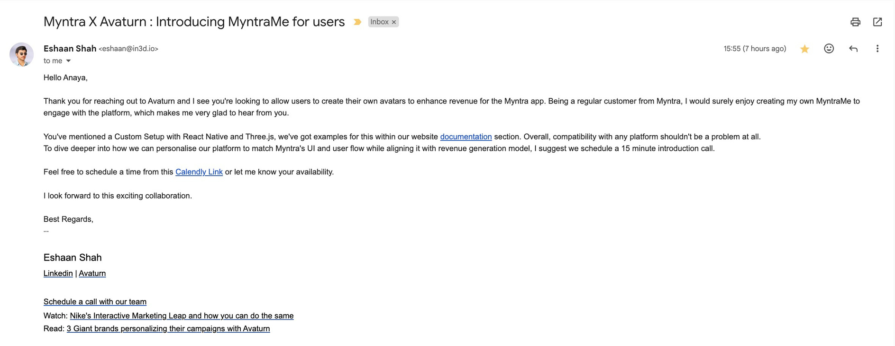
Future Prospects: Myntra X Avaturn Collaboration
We are excited to announce a potential collaboration with Myntra through Avaturn. This collaboration aims to enhance user engagement and generate revenue for the Myntra app by allowing users to create their own avatars
KEY HIGHLIGHTS:
Personalization: Our platform can be personalized to match Myntra's UI and user flow while aligning with their revenue generation model.
Customization: The integration will feature a custom setup with React Native and Three.js, ensuring compatibility with any platform.

Slide 5

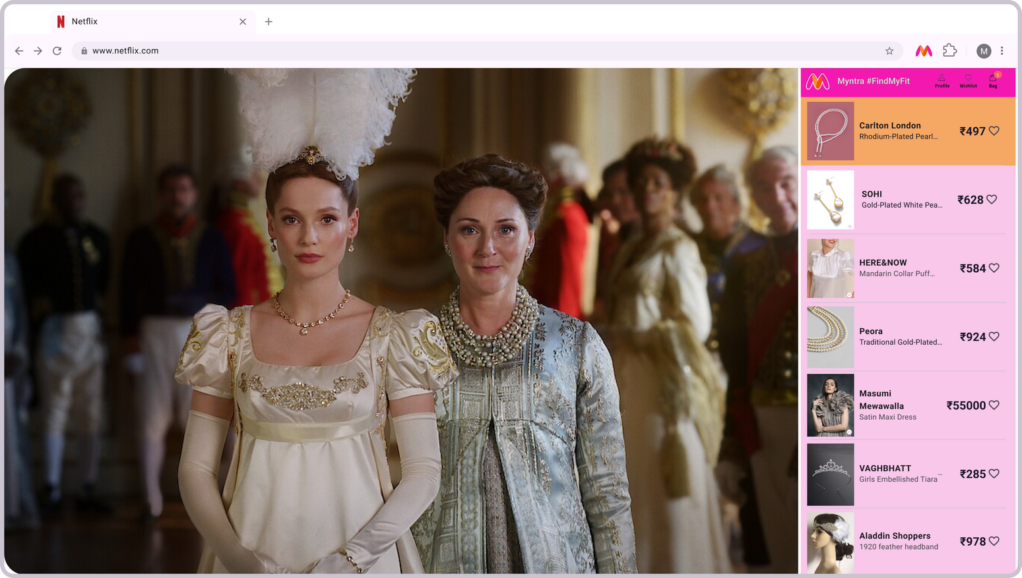
Solution 2
Add Myntra’s #FindMyFit chrome extension and use it anytime, anywhere!
Idea:
BROWSER EXTENSION FOR SEAMLESS SHOPPING INTEGRATION: #FINDMYFIT
To extend the shopping experience beyond the Myntra platform, a browser extension can be added, enabling users to discover similar products while browsing the web. When watching a series or browsing content online, the extension identifies clothing and accessories and provides links to similar products available on Myntra. This seamless integration allows users to instantly shop for items they find appealing, capitalizing on spontaneous shopping impulses and driving additional traffic to Myntra's site.
Tech-Stack:
Frontend: JavaScript, HTML/CSS
Frameworks: Browser Extension APIs, Selenium, React
Backend: Node.js, Express.js
Database: MongoDB
API Integration: Myntra API, Browser API
#no
FOMO
Never miss out on the latest trendsss!
Focus:
Platform:
SHOP WHAT YOU SEE: INSTANTLY DISCOVER AND BUY SIMILAR PRODUCTS WITH MYNTRA'S NEW BROWSER EXTENSION
MYNTRA'S WEBSITE

Slide 6
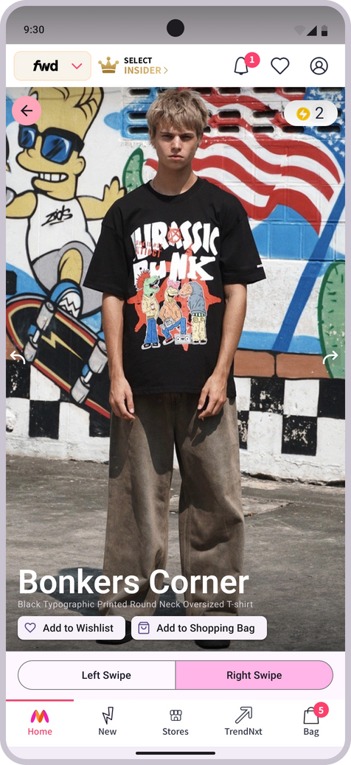
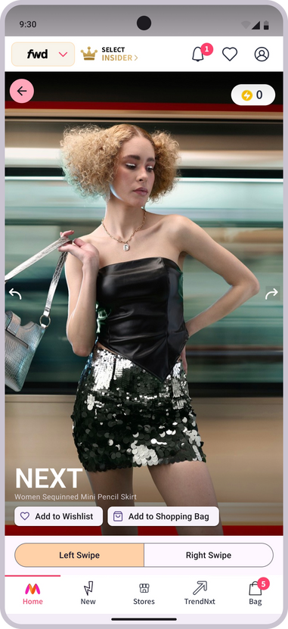
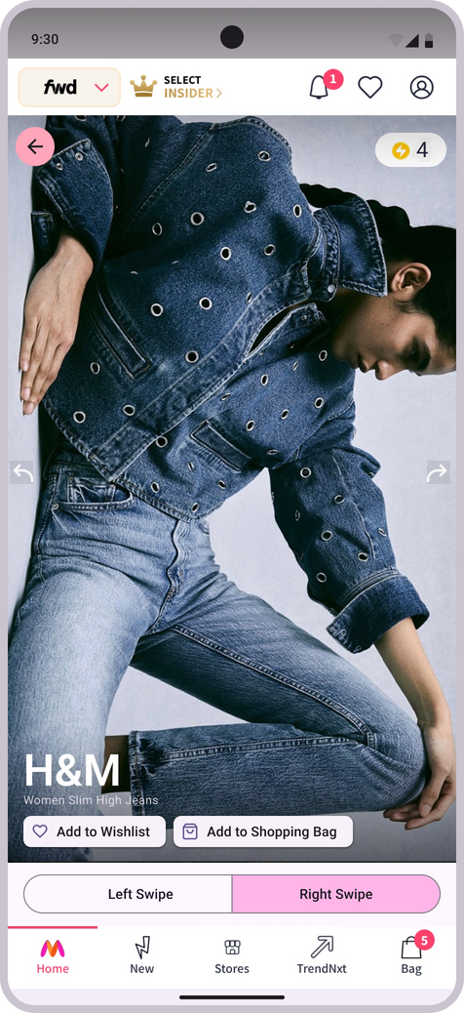
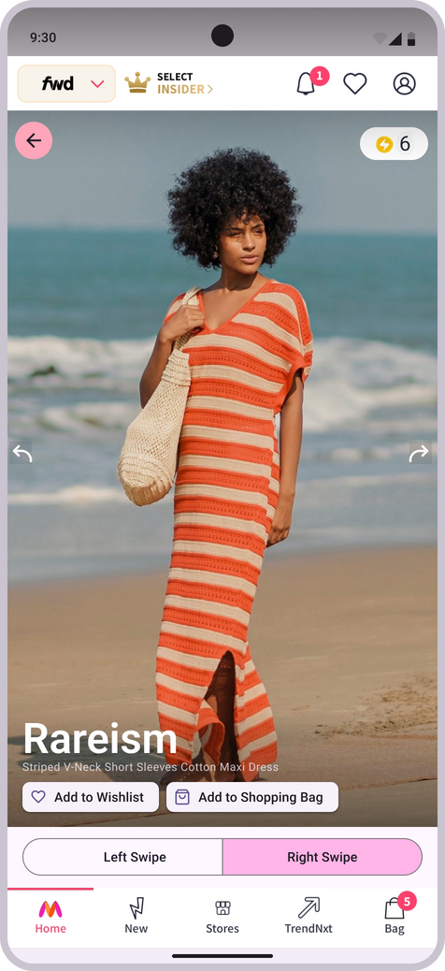
Solution 3
Idea:
Earn Myntra SuperCoins for every swipe!
PERSONALIZED FEED WITH SWIPE-BASED INTERACTION:
Myntra can enhance user engagement by implementing a swipe-based recommendation system where users can swipe left or right to indicate their preferences. Each user is allowed up to five right swipes per day, making their choices more deliberate. With every swipe, users earn points that accumulate towards discounts on future orders. This gamified approach not only makes shopping more interactive and enjoyable but also incentivizes regular use, leading to increased customer loyalty and higher conversion rates.
Focus:
FASHION FORWARD ENGAGEMENT: REVOLUTIONIZING USER INTERACTION ON MYNTRA WITH SWIPE-BASED TREND IDENTIFICATION
Left swipe = CANCELLED!
Tech-Stack:
Platform:
#SIMPing
Frontend: Javascript, React
Backend: Node.js, Express.js
Database: MongoDB
API Integration: Myntra API, Browser API
Authentication: JWT, OAuth
Machine Learning: TensorFlow/PyTorch, Collaborative Filtering, Neural Collaborative Filtering (NCF), Recurrent Neural Networks (RNNs)
MYNTRA'S MOBILE
APPLICATION
Right swipe for the looks that SLAPS!
Swipe and Earn!

Slide 7
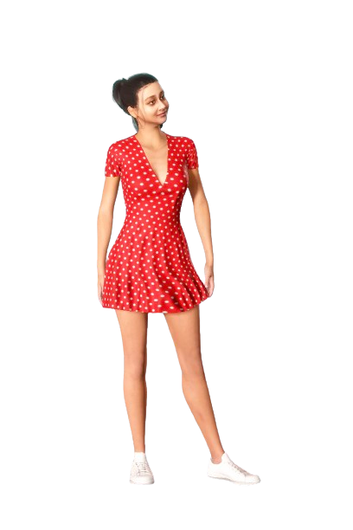
Benefits
#No
CAP
Virtual Fashion Integration: Seamlessly shop on Myntra from any site with our browser extension.
Personalized Swipe Feed: Tailor product suggestions with effortless liking and disliking.
Gamified Shopping: Earn points for swiping and redeem for discounts, making shopping fun.
Higher Conversion Rates: Boost sales by enhancing user satisfaction and loyalty.
Cross-Platform Integration: Connect browsing to shopping for a seamless experience.
Expanded Brand Reach: Reach new customers during their everyday online activities.
Data-Driven Personalization: Use swipe data for precise recommendations.
Community Engagement: Build a vibrant shopper community with gamification.
Continuous Improvement: Evolve with user data and feedback to meet needs.
Github link: https://github.com/ananyabansal16/Myntra-WeForShe-MynChamps

